Slide 1


Exploratory Data Analysis on Used Cars
Project by Samir Nagure

Slide 2

Introduction
The demand for used cars has certainly increased from pre-pandemic times. The used vehicle market is facing supply constraints due to three factors:
Customers are holding on to their used vehicles and not selling them as they were doing before the pandemic,
Exchanges have been impacted due to continued challenges in the new car market, and,
Repossessions have virtually stopped since April due to the ongoing loan moratorium.
Due to supply constraints and unpredictable nature of the lockdown, sales were impacted during the first few months
In this exploratory data analysis, we are trying to analyze the used car sales data to find interesting analysis.

Slide 3
Problem Statement
In the past few years, prices of new cars have skyrocketed, due to which most people are incapable of buying a new one.
Customers buying a new car always looks for assuerity of their money to be worthy.
But due to the increased price of new cars, used car sales are on a global increase (Pal, Arora and Palakurthy, 2018).
There is a need for a used car price prediction system to effectively determine the worthiness of the car using a variety of features.
Even though there are websites that offers this service, their prediction method may not be the best.
Besides, different models and systems may contribute on predicting power for a used car’s actual market value.
It is important to know their actual market value while both buying and selling.
Derive a scenario related to the problem statement and heads on to the journey of exploration.
My Car, an Indian company buys and sells secondhand cars.
The company has earned its name because of sincerity in work and quality of services.
But for past few months their sales is down for some reason, and they are unable to figure it out.

Slide 4
Observations Found in the Dataset
Have observe there are missing/null values in engV and drive columns.
434 null values will be replaced with mean for engV column
510 null values will be replaced with mode for drive column
From the sample data and with the help of describe and info functions we can infer that mileage column and engV column seem to have outliers with very extreme values of 999 and 99.
There are 87 duplicate rows in the dataset which need to be dropped.

Slide 5
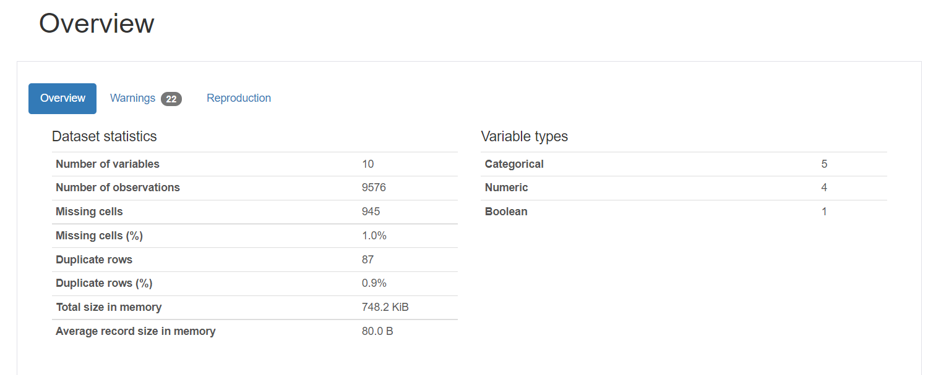
Pandas Profiling Overview & Warning Report
There are 87 duplicated rows (Action - Remove the duplicates)
1% of missing cells are in the dataset (Action - Replace with default/mean value or discard the records)
5 Categorical variables (car, body, engType, model, & drive)
4 numeric variables (price, milage, engV & year) and
1 Boolean (registration) value

Slide 6
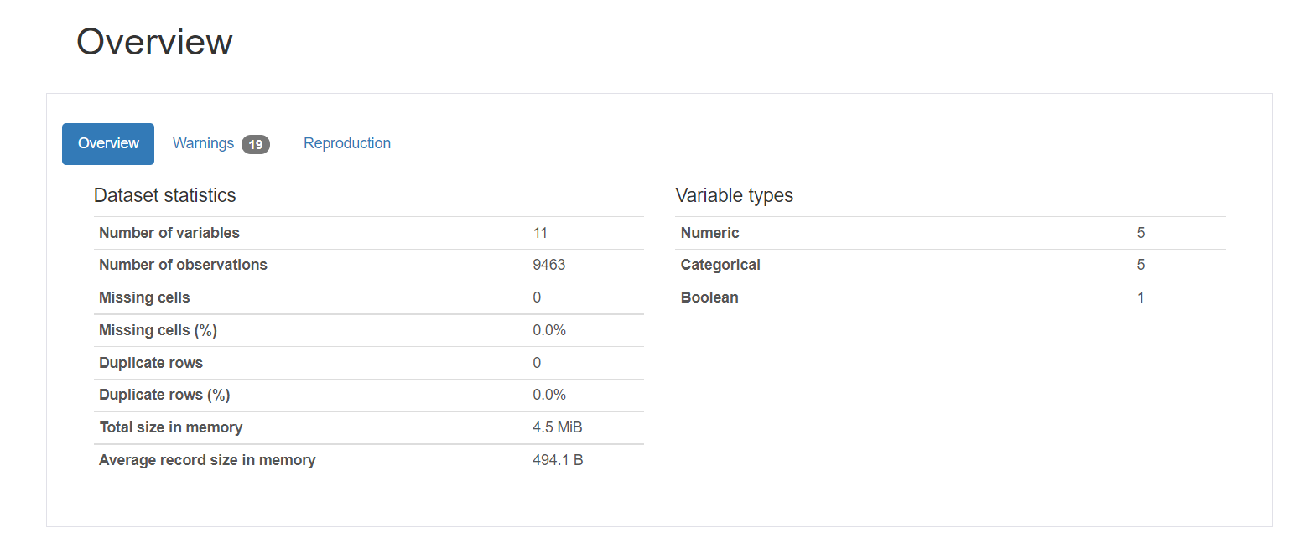
Pandas Profiling Overview & Warning Report – Post Data Cleaning
There are 0 duplicated rows
0% of missing cells are in the dataset
5 Categorical variables (car, body, eng Type, model, & drive)
5 numeric variables (price, milage, engV, eng Type & year) and
1 Boolean (registration) value

Slide 7
Exploratory Data Analysis
Questions Covered
Top 10 most sold car brands?
Which body segment of cars sold the most ?
Bar chart & Pie Chart of car body segment in terms of %age
Which Engine Type segment of cars sold the most ?
Which Price segment of cars sold the most ?
Distribution of vehicles based on year of registration ?
Which engine volume (engV) cars sold the most
Top 10 highest price selling car and their model details
Top 10 lowest price selling car and their model details
Correlation between various features of car data
Price v/s Production year

Slide 8
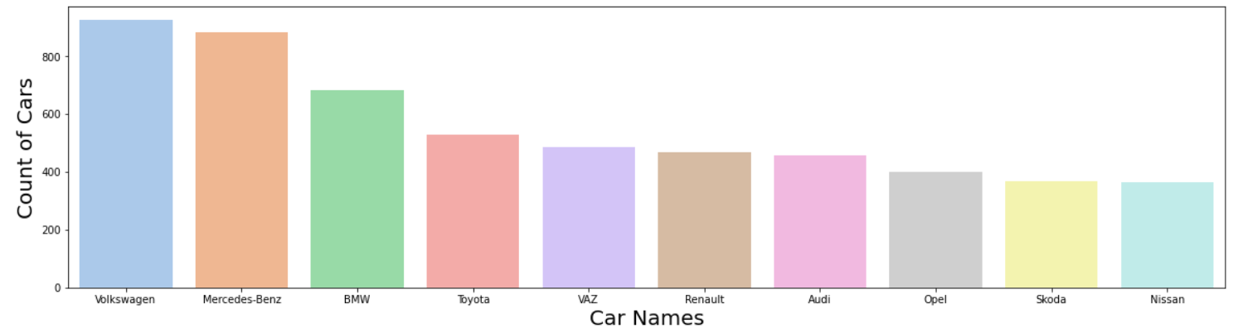
Q1. Top 10 most sold car brands?
Most of the cars were sold by Volkswagen followed by Mercedes-Benz and BMW.

Slide 9
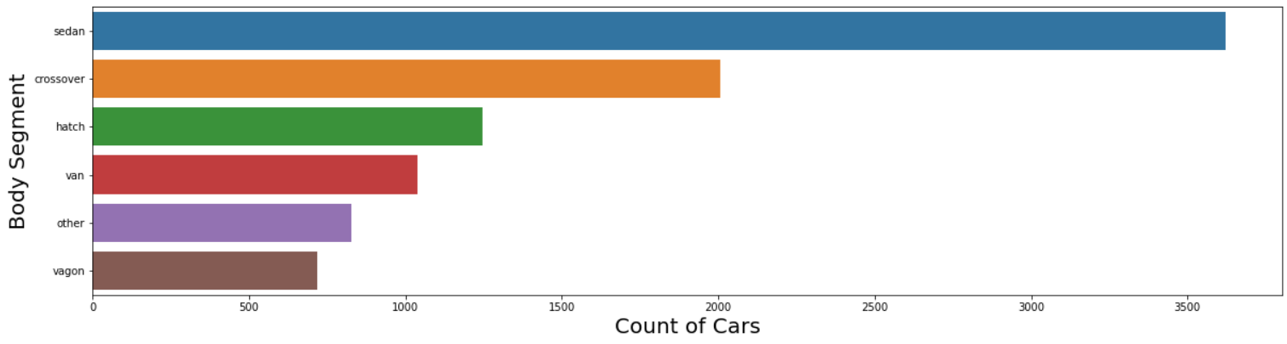
Q2. Which body segment of cars sold the most?
Sedan cars segment is most popular and most selling segment as compare to others.

Slide 10
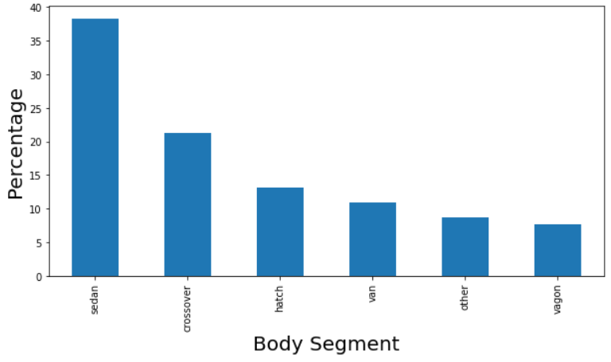
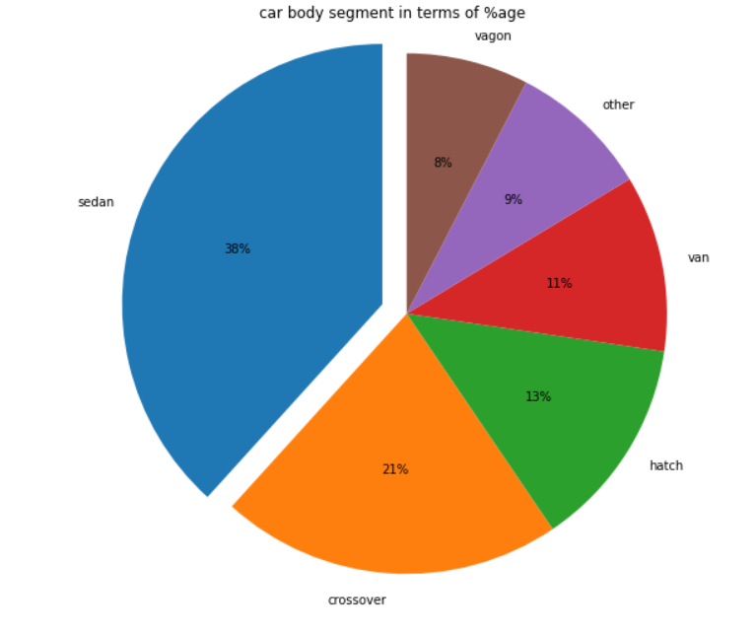
Q3. Bar chart & Pie Chart of car body segment in terms of %age
BAR Chart of Car Body Segment in terms of %age
PIE Chart of Car Body Segment in terms of %age

Slide 11
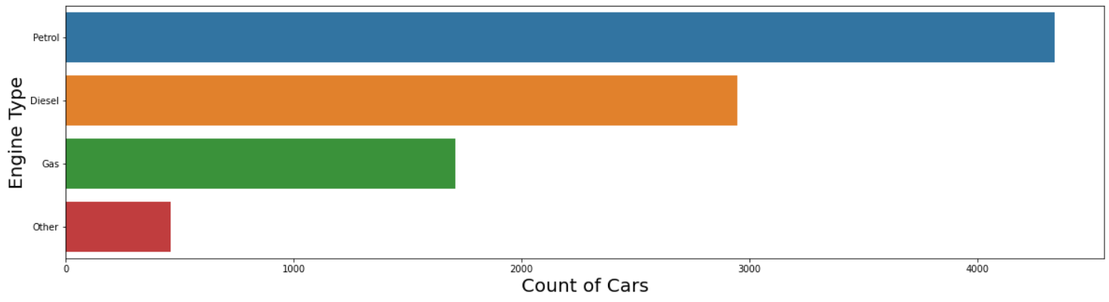
Q4. Which Engine Type segment of cars sold the most?
Petrol cars are sold the most as compare to Diesel, Gas & Other Eng Type.

Slide 12
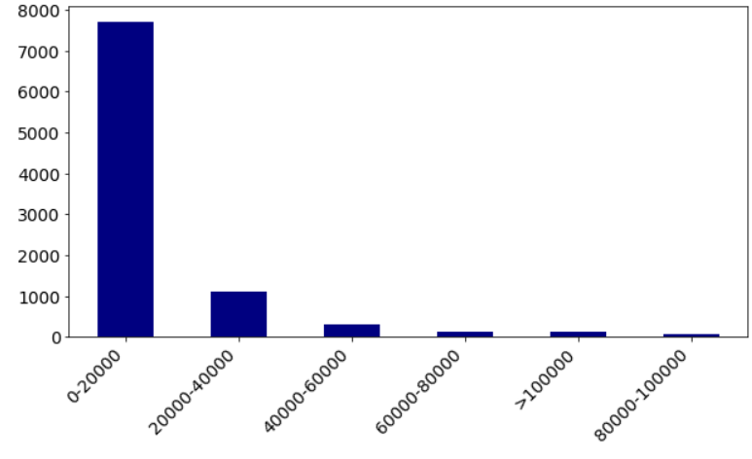
Q5. Which Price segment of cars sold the most ?
0-20000 Price group has most sold cars segment.

Slide 13
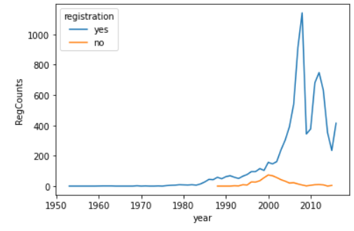
Q6. Distribution of vehicles based on year of registration ?
Most of the cars have registered in the year 2008 (viz. 1142 Cars) followed by 2007, 2012, 2011 & 2013…

Slide 14
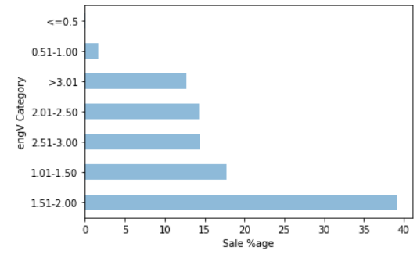
Q7. Which engine volume (engV) cars sold the most?
EngV 1.51-2.00 category has the most cars sold viz. 39% out of all categories

Slide 15
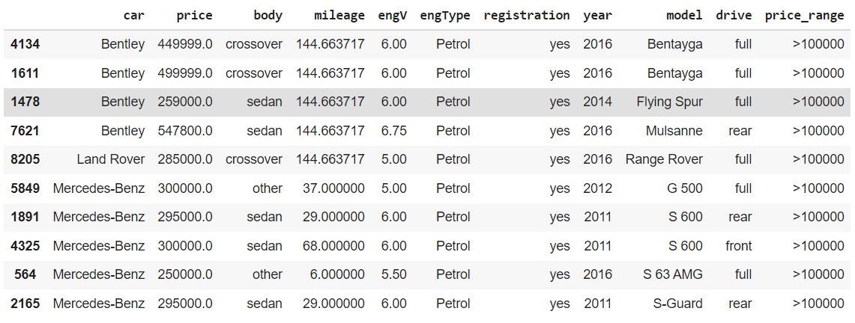
Q8. Top 10 highest price selling car and their model details
Bentley, Land Rover & Mercedes-Benz are the highest price selling cars

Slide 16
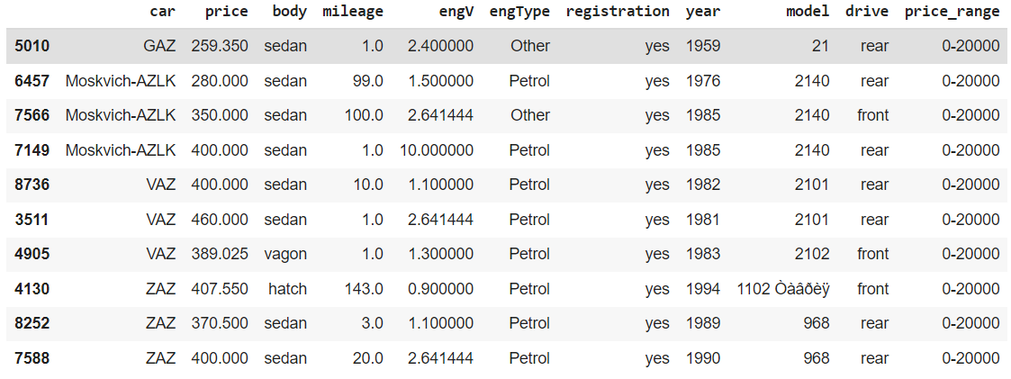
Q9. Top 10 lowest price selling car and their model details
Q9. Top 10 lowest price selling car and their model details
GAZ, Moskvich-AZLK, VAZ & ZAZ are the lowest price selling cars

Slide 17
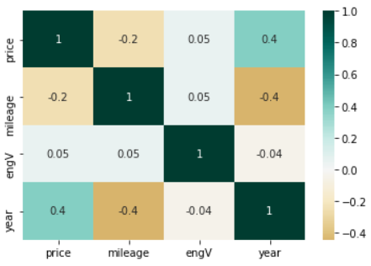
Q10. Correlation between various features of car data
price and year have strong positive correlation
price and engV have mild positive correlation
engV and mileage have positive correlation
year and mileage have strong negative correlation
price and mileage have negative correlation
year and engV also have mild negative correlation.

Slide 18
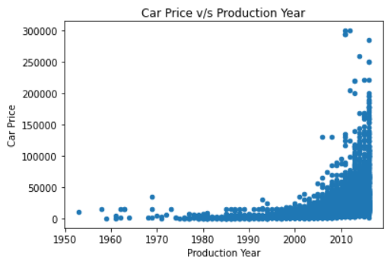
Q11. Price v/s Production year
Before 2010 the cars selling price was below 50,000 for almost all brands
Post 2010 the price was increased and most of the cars sold in more than the price of 50,000

Slide 19
Summarization
Conclusion (Observations)
Most of the cars were sold by Volkswagen followed by Mercedes-Benz and BMW.
Sedan cars segment is most popular and most selling segment as compare to others.
We have Bentley & Mercedes-Benz in to 10 highest price selling cars
As per the dataset, Petrol Engine Type segment of cars sold the most
Actionable Insights
Economy cars from Petrol & Diesel segment had most selling %age as compare to others. That means, economy cars had more demand in the market
EngV 1.51-2.00 cars had most sale
Sedan body type had most sale as compare to other ones
Volkswagen, Mercedes-Benz, BMW, Toyota & VAZ were most popular brands in the market as per their selling %age

Slide 20
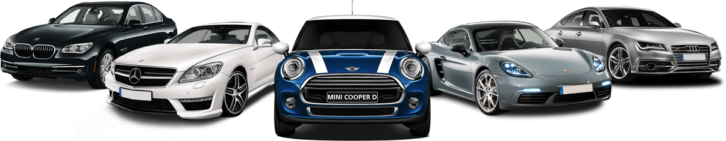
THANK YOU

